Slide 1
Looking further into DropOut

Slide 2
Questions from the discussion
Convolutional Neural Networks:
Fei-Fei Li & Andrej Karpathy & Justin Johnson
Understanding of a Convolutional Neural Network – Albawi, 2017
Visualizing and Understanding Convolutional Neural Network – Zeiler 2013

Slide 3
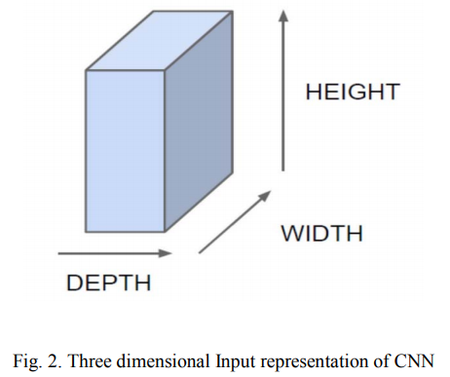
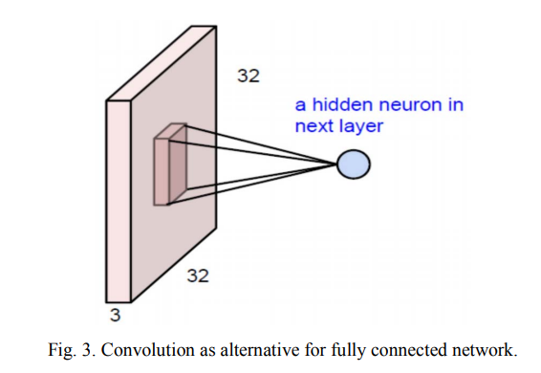
Why use a Convolutional Network
The depth of the filter = depth of the image (for coloured = 3)
For a 32x32x3 image and 5x5x3 filter, output is 28x28x1

Slide 5
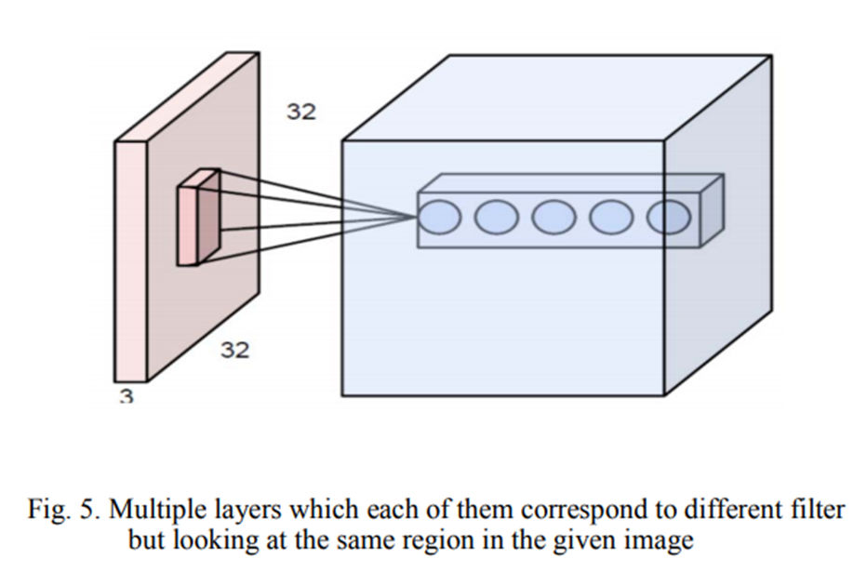
Why use a Convolutional Network

Slide 6
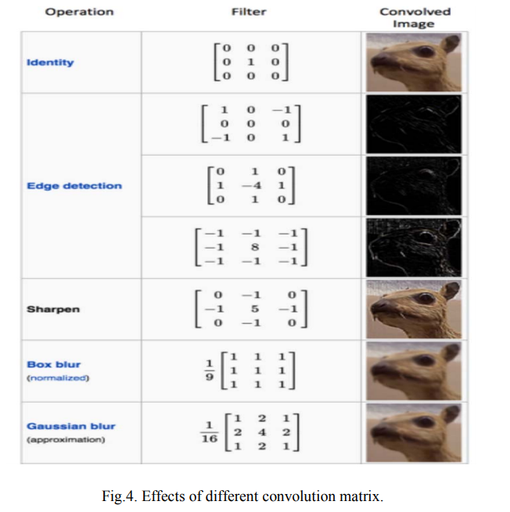
Pre defined matrices

Slide 7
Questions from the paper
Max out unit in a neural network –
Maxout Networks (Goodfellow et al.)
Evaluation of maxout activations in deep learning across several big data domains (Gabriel Castaneda et al.)

Slide 8

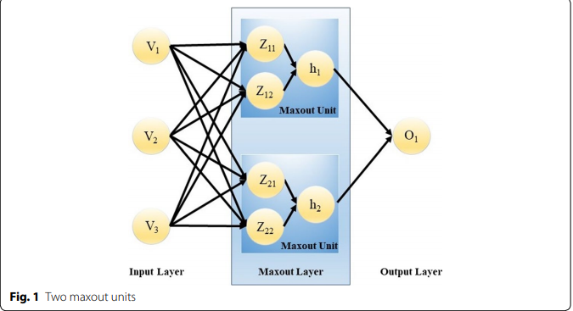
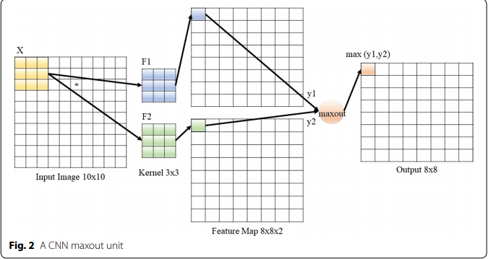
Maxout units in various networks
Castaneda et al

Slide 9
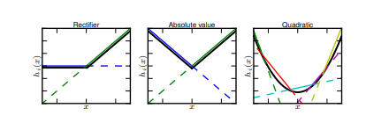
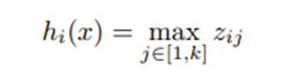

Maxout units in various networks
Goodfellow et al

